Slide 1
Data (what data & how to collect it
Week 3

Slide 2
Recap
In Week 2
  Usability testing in the context of UX research methods
  Where usability testing fits in the SDLC
  Usability testing methods based on what we want to achieve
  Quallitative vs Quantitative and Attitudinal vs Behavioural
  What usability testing methods to use
This week we will look more extend
  Data
  Data and methods to collect the correct data

Slide 3
Usability testing process
Usability testing goal – research question
Hypothesis
Data collection methods
Analysis
Reporting the research outcomes
A clear objective/goal:
  makes is easier to create a proper list of usability testing questions (the research questions)
  create hypothesis
  those will determine the test material to be created
  test plan
Before you start planning for usability testing you need to define the objectives/goal of the usability testing study, in other words what you want to achieve, and why

Slide 4
Usability testing types of study/research goals
Descriptive Investigation/Research
Relational Investigation/Research
Experimental/Causal Investigation/Research

Slide 5
Descriptive Investigation/Research
Descriptive investigation/research is a quantitative research method, which corresponds to identifying the characteristics of an observed phenomenon and collecting more information.
This research method is designed to depict the participants in a very systematic and accurate manner. In simple words, descriptive research is all about describing the phenomenon, observing and drawing conclusions from it.

Slide 6
Descriptive Investigation/Research Example
Finding Things to do in a City
  Use kayak.com to find 5 different things to do in in Tokyo next week.
An example of this type of research would be to study the users’ choice of the most popular things to do in the city. Descriptive studies do not seek to measure the effect of a variable; they seek only to describe it.

Slide 7
Relational Investigation/Research
Relational Investigation/Research investigates the connection between two or more variables/factors.
The variables/factors that are compared are generally already present in the group or population.

Slide 8
Relational Investigation/Research Example
  Finding Things to do in a City
  Use kayak.com to find 5 different things to do in in Tokyo next week.
For example, a study that looked which destinations were more popular for male and female, would be studying the popularity of destinations in different gender.

Slide 9
Experimental/Causal Investigation/Research
Experimental/Causal investigation/Research investigates the effect of one or more variables on one or more outcome variables, or if one variable causes another variable to occur or change.
  An example of this type of research would be altering the amount of a treatment and measuring the effect on study participants.

Slide 10
Experimental/Causal Investigation/Research Example
Finding Things to do in a City
  Use kayak.com to find 5 different things to do in the city, and study the effect of the picture style to advertise a destination for “things to do” in selecting the location.
For example, a study that looked at which destinations were more popular to visit in Tokyo among based on the size of the style of the picture used to advertise the destination (large, medium or small picture, framed or not frames etc.), studying the relationship between picture style to advertise a destination in “things to do” and users’ choice.

Slide 11
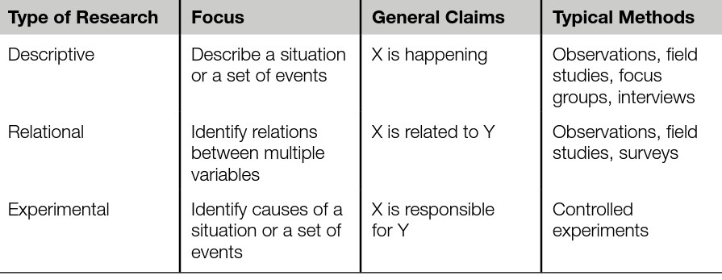
Type of Research
Table 2.1 Relationship Between Descriptive Research, Relational Research, and Experimental Research
Lazar, J., Feng, J.H. and Hochheiser, H. (2017) Research methods in human-computer interaction. Second edition. Cambridge, Massachusetts: Morgan Kaufmann Publishers, pp. 27

Slide 12
Necessary background information
Before we jump into discussing what we study statistically in the aforementioned methods we need to understand some background information about:
  Variables
  Data types

Slide 13
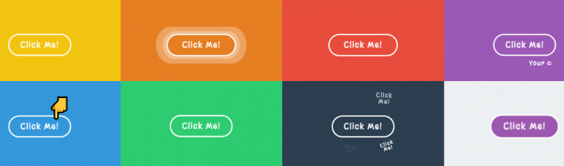
Variables
A variable is something that can be changed, such as a characteristic or value. Variables are generally used to determine if changes to one thing result in changes to another.
What is about those buttons that makes you want to click them?

Slide 14
Variable types
There are two types of variables:
  Independent variables are the things that are controlled and manipulated by the experimenter (such as designs you’re testing or the characteristics of the participants (age, gender)).
    For example, in an experiment on the impact of the colour on user performance, the colour would be the independent variable.
  Dependent variables are the variables that are measured by the experimenter, such as performance: success rates, number of errors, completion times, or user satisfaction, preference and many more.

Slide 15
Tip
When designing a usability testing study, you should have a clear idea of what you plan to manipulate (independent variables) and what you plan to measure (dependent variables). The most interesting outcomes of a study are at the intersection of the independent and dependent variables, such as whether one design resulted in a higher task success rate than the other.

Slide 16
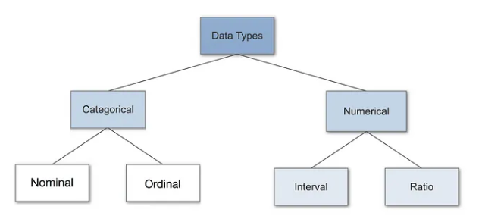
Type of data
When collecting and analyzing user experience data, you should know what type of data you’re dealing with and what you can and can’t do with each type.
Qualitative
Quantitative

Slide 17
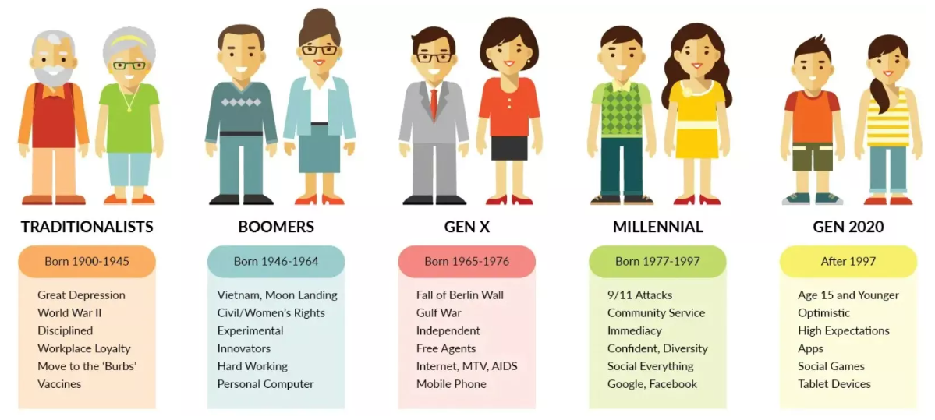
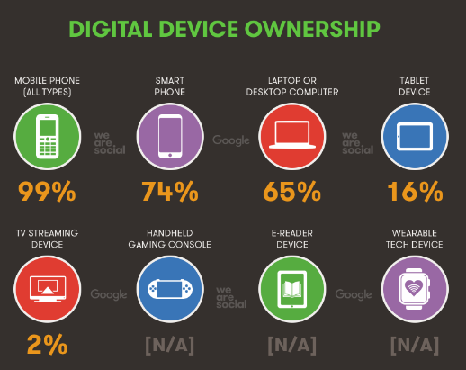
Nominal Data in Usability Testing context
?

Slide 18

Nominal Data in Usability Testing context
Nominal (categorical) data are unordered groups or categories.
Here are a few examples of typical nominal data in Usability testing context:
  Error Types: Categories of errors users encounter, such as "navigation error," "form submission error," "button misclick," or "input error."
  Device Type: The type of device used during testing, such as "desktop," "tablet," or "mobile."
  User Feedback Categories: Responses to qualitative feedback questions like, "What did you like most about the product?" with categories such as "design," "usability," "speed," or "features."
  Preferred Language: Language preference when testing multilingual software, such as "English," "Spanish," "French," etc.
  Task Outcomes: Categories of task outcomes like "completed successfully," "incomplete," or "failed."
  User Demographics: Basic demographic categories such as "age group" (e.g., "18–24," "25–34") or "user type" (e.g., "new user," "returning user").
  Satisfaction Levels: General categories of user satisfaction like "very satisfied," "satisfied," "neutral," "dissatisfied," "very dissatisfied" when analyzing open-ended responses.
  Interface Preferences: Responses indicating preferred interface styles, such as "dark mode" or "light mode".

Slide 19
Nominal Data - variables
Here’s how some of the examples from above could be structured with independent and dependent variables:
  Error Types:
    Independent Variable: The type of error (e.g., "navigation error," "form submission error," "button misclick," "input error").
    Dependent Variable: User task success rate or the time taken to complete the task.
  Device Type:
    Independent Variable: Device used during testing (e.g., "desktop," "tablet," "mobile").
    Dependent Variable: Task completion time, number of errors made, or user satisfaction score.
  User Feedback Categories:
    Independent Variable: Category of the product feature (e.g., "design," "usability," "speed," "features").
    Dependent Variable: User satisfaction rating for each feature category or frequency of mentions in user feedback.
  Preferred Language:
    Independent Variable: Language chosen by the user (e.g., "English," "Spanish," "French").
    Dependent Variable: Task completion time, error rate, or user satisfaction in each language.
  Task Outcomes:
    Independent Variable: Task type or difficulty level (e.g., "easy," "moderate," "difficult").
    Dependent Variable: Task outcome (e.g., "completed successfully," "incomplete," "failed").
  User Demographics:
    Independent Variable: Age group or user type (e.g., "18–24," "25–34," "new user," "returning user").
    Dependent Variable: Task completion rate, error frequency, or satisfaction score based on different demographic groups.
  Satisfaction Levels:
    Independent Variable: Type of interface element being tested (e.g., "navigation," "search function," "checkout process").
    Dependent Variable: User satisfaction rating (e.g., "very satisfied," "satisfied," etc.) for each element.I
  Interface Preferences:
    Independent Variable: Interface style (e.g., "dark mode," "light mode").
    Dependent Variable: User preference rating, task completion time, or overall satisfaction.
In usability testing, independent variables are the factors you manipulate or categorize to observe their effect on other variables, while dependent variables are the outcomes or responses you measure as a result of those manipulations.

Slide 20
Nominal Data in Usability Testing context
Among the statistics you can use with nominal data are simple descriptive statistics such as counts and frequencies.
For example, you could say that 45% of the users are female, there are 200 right-handed users, or 95% were successful on a particular task.

Slide 21
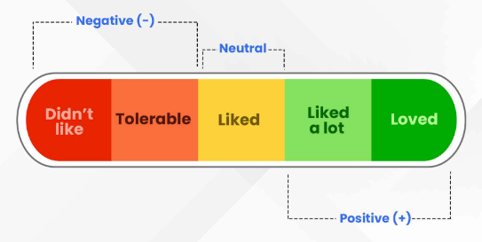
Ordinal Data in Usability Testing context
?

Slide 22

Ordinal Data in Usability Testing context
Here are some examples of ordinal data in a usability testing context:
  User Satisfaction Ratings: Asking users to rate their satisfaction with the product on a scale, such as:
    "Very satisfied," "Satisfied," "Neutral," "Dissatisfied," "Very dissatisfied."
  Task Difficulty Levels: Asking users to rate how difficult they found a task, with responses like:
    "Very easy," "Easy," "Moderate," "Difficult," "Very difficult ." Agreement Levels on Statements: Asking users how much they agree with a statement about the product, like: "Strongly agree," "Agree," "Neutral," "Disagree," "Strongly disagree."
  Frequency of Errors: Categorizing the frequency of errors or issues experienced by users, such as:
    "Never," "Rarely," "Sometimes," "Often," "Always."
  Usability Score Ranks: Ranking the usability of multiple versions of an interface:
    "Best," "Second best," "Third best," etc.
  User Expertise Level: Categorizing users based on their self-reported expertise or familiarity with the product:
    "Beginner," "Intermediate," "Advanced," "Expert ."
  Priority of Issues: Ranking the priority of issues identified during usability testing:
    "Low priority," "Medium priority," "High priority," "Critical."
In usability testing, ordinal data represents categories with a meaningful order, but the intervals between categories are not necessarily equal

Slide 23
Ordinal Data - variables
Here’s how some of the examples from above could be structured with independent and dependent variables:
  User Satisfaction Ratings:
    Independent Variable: Interface design version (e.g., "Version A," "Version B," "Version C") or feature type (e.g., "navigation," "checkout process," "search function").
    Dependent Variable: User satisfaction rating (e.g., "Very satisfied," "Satisfied," "Neutral," etc.).
  Task Difficulty Levels:
    Independent Variable: Task complexity (e.g., "simple task," "moderate task," "complex task") or type of task (e.g., "search task," "checkout task," "profile setup task").
    Dependent Variable: User-reported task difficulty level (e.g., "Very easy," "Easy," "Moderate," etc.).
  Agreement Levels on Statements:
    Independent Variable: Specific feature or element (e.g., "navigation menu," "search function," "checkout process").
    Dependent Variable: Level of agreement with usability statements about the feature (e.g., "Strongly agree," "Agree," "Neutral," etc.).
  Frequency of Errors:
    Independent Variable: Task type or task difficulty (e.g., "low," "moderate," "high" difficulty).
    Dependent Variable: Frequency of errors (e.g., "Never," "Rarely," "Sometimes," etc.) encountered while completing the task.
  Usability Score Ranks:
    Independent Variable: Different interface versions or design changes (e.g., "Original," "Revised Version 1," "Revised Version 2").
    Dependent Variable: User-ranked usability score (e.g., "Best," "Second best," "Third best").
  User Expertise Level:
    Independent Variable: User's self-reported expertise level (e.g., "Beginner," "Intermediate," "Advanced," "Expert").
    Dependent Variable: Task completion time or number of errors made in usability tasks, as influenced by the user's expertise.
  Priority of Issues:
    Independent Variable: Specific usability issue type (e.g., "navigation," "button placement," "form submission").
    Dependent Variable: Priority level assigned to each issue based on user feedback or frequency (e.g., "Low priority," "Medium priority," "High priority," "Critical").
In usability testing, independent variables are the factors you manipulate or categorize to observe their effect on other variables, while dependent variables are the outcomes or responses you measure as a result of those manipulations.

Slide 24
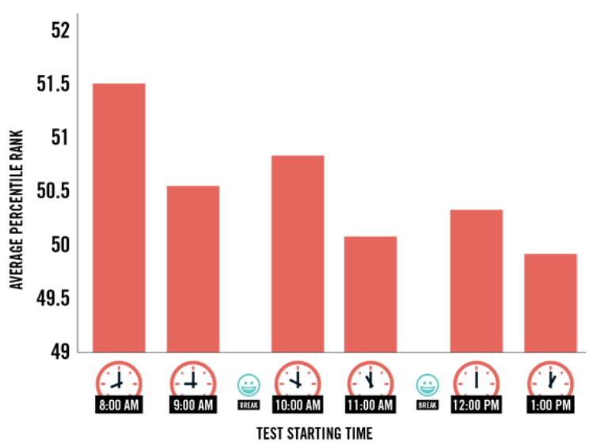
Interval Data
?

Slide 25
Interval Data in Usability Testing context
In usability testing, interval data has ordered categories with equal intervals between them but no true zero point, allowing for meaningful addition and subtraction but not for true ratios (e.g., you can’t say “twice as much”).
Here are some examples of interval data in a usability testing context:
  User Satisfaction Ratings on a Likert Scale:
    For example, a scale from 1 to 7 (where 1 = "Very dissatisfied" and 7 = "Very satisfied"). Although technically ordinal, Likert scales are often treated as interval data in usability studies, especially when calculating averages.
  System Usability Scale (SUS) Scores:
    The SUS is a widely used questionnaire that generates a score from 0 to 100, but the scores are treated as interval data. This scale allows researchers to calculate averages and measure differences in usability across versions of a product.
  Confidence Ratings:
    Asking users how confident they feel about completing tasks on a scale, for example, 1 to 5 (where 1 = "Not confident at all" and 5 = "Very confident"). This allows researchers to calculate mean confidence levels across users.
  Mental Effort Ratings:
    Using a scale like 1 to 10 to rate how mentally demanding a task was, where 1 = "Not demanding" and 10 = "Extremely demanding." This allows for analyzing the perceived cognitive load in usability tasks.
  Perceived Ease of Use:
    Asking users to rate how easy a feature or product is to use on a scale from 1 to 10 (where 1 = "Very difficult" and 10 = "Very easy"). These ratings can help identify challenging aspects of the interface.
  Time of Day During Testing:
    If you’re measuring when users complete tasks (e.g., using a 24-hour clock format), the time of day is interval data. It can help analyze whether performance varies depending on the time at which testing is conducted.
  Temperature of the Testing Environment:
    If recorded in degrees (e.g., Celsius or Fahrenheit), this could be useful in understanding any impact of environmental factors on usability performance, though it’s a less common metric.

Slide 26
Interval Data - variables
Here’s how some of the examples from above could be structured with independent and dependent variables:
  User Satisfaction Ratings on a Likert Scale:
    Independent Variable: Design version (e.g., "Version A" vs. "Version B") or feature type (e.g., "navigation," "search," "checkout").
    Dependent Variable: User satisfaction rating (e.g., a 1 to 7 scale where 1 = "Very dissatisfied" and 7 = "Very satisfied").
  System Usability Scale (SUS) Scores:
    Independent Variable: Product version or different interface designs being tested.
    Dependent Variable: SUS score (on a scale from 0 to 100), reflecting overall perceived usability.
  Confidence Rating:
    Independent Variable: Task complexity (e.g., "simple," "moderate," "complex") or user group (e.g., "beginner" vs. "experienced").
    Dependent Variable: User confidence rating on a scale (e.g., 1 to 5, where 1 = "Not confident at all" and 5 = "Very confident")
  Mental Effort Ratings:
    Independent Variable: Task type (e.g., "navigation," "search," "checkout") or design element being evaluated.
    Dependent Variable: Mental effort rating (e.g., on a scale of 1 to 10 where 1 = "Not demanding" and 10 = "Extremely demanding").
  Perceived Ease of Use:
    Independent Variable: Specific feature being tested (e.g., "login process," "settings menu") or different versions of a feature.
    Dependent Variable: Ease of use rating on a scale (e.g., 1 to 10, where 1 = "Very difficult" and 10 = "Very easy").
  Time of Day During Testing:
    Independent Variable: Time of day (e.g., morning, afternoon, evening).
    Dependent Variable: Task completion time or number of errors made, to observe if time of day affects user performance.
  Temperature of the Testing Environment:
    Independent Variable: Room temperature in degrees Celsius or Fahrenheit.
    Dependent Variable: User comfort rating or task completion speed, if you are testing for potential environmental impact on performance.
In usability testing, independent variables are the factors you manipulate or categorize to observe their effect on other variables, while dependent variables are the outcomes or responses you measure as a result of those manipulations.

Slide 27


Are ratings interval data?
One of the debates you can get into with people who collect and analyze subjective ratings is whether you must treat the data as purely ordinal or if you can treat it as being interval. Consider these two rating scales:
Putting explicit labels on items in the scale makes the data ordinal
Labelling the end-points makes the data more “interval-like,” which is why most subjective rating scales only label the ends.
Presenting it that way, with 9 points along the scale, makes it even more obvious that the data can be treated as if it were interval data

Slide 28
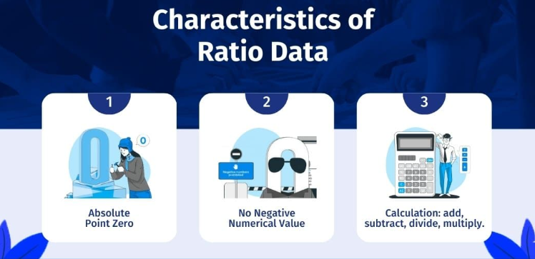
Ratio
?

Slide 29
Ratio Data
Ratio data are the same as interval data but with the addition of an absolute zero.
In usability testing, ratio data has an absolute zero point, which allows for meaningful comparisons using multiplication and division
Here are some examples of ratio data in the context of usability testing:
  Task Completion Time:
    The time it takes users to complete a task (measured in seconds or minutes). Since time has a true zero (no time means the task wasn’t started), you can say one task took "twice as long" as another.
  Number of Errors:
    The number of mistakes or errors users make while performing a task. With a true zero (no errors), this allows you to compare error rates across different tasks or interface versions.
  Number of Clicks to Complete a Task:
    The count of clicks users make to finish a task. Zero clicks means the task wasn’t attempted, allowing comparisons like "Task A required twice as many clicks as Task B.“
  Task Completion Rate:
    The percentage of users who successfully complete a task. Although a percentage, it’s treated as ratio data since 0% means no completions, and you can compare completion rates across tasks.
  Time on Page:
    The amount of time users spend on a specific page (measured in seconds or minutes). This helps determine whether users are struggling with content or navigation on that page.
  User Actions per Task:
    The count of specific actions (e.g., scrolling, zooming, or swiping) users perform while completing a task. Zero actions mean no interaction, so you can analyze if a task requires excessive interactions.
  Distance Traveled with Mouse or Touch Gestures:
    The distance users move their cursor or finger to complete a task (measured in pixels or centimeters). This helps in identifying if the layout forces users to move excessively, and a true zero represents no movement.
  Help Requests or Hints Used:
    The number of times users request help or use hints to complete a task. Zero hints used indicates task independence, allowing for comparisons across tasks or user groups.

Slide 30
Ratio Data - variables
Here’s how some of the examples from above could be structured with independent and dependent variables:
  Task Completion Time:
    Independent Variable: Task type or complexity (e.g., "simple," "moderate," "complex") or design version (e.g., "Version A" vs. "Version B").
    Dependent Variable: Time taken to complete the task (measured in seconds or minutes).
  Number of Errors:
    Independent Variable: Interface design or task type (e.g., "navigation task," "search task").
    Dependent Variable: Number of errors made by the user during the task.
  Number of Clicks to Complete a Task:
    Independent Variable: Task flow or design version (e.g., "Version A" with fewer steps vs. "Version B" with more steps).
    Dependent Variable: Number of clicks users need to complete the task..“
  Task Completion Rate:
    Independent Variable: User group (e.g., "beginner," "intermediate," "advanced") or task difficulty level (e.g., "easy," "medium," "hard").
    Dependent Variable: Percentage of users who complete the task successfully..
  Time on Page:
    Independent Variable: Page type (e.g., "home page," "product page," "checkout page") or content type on the page.
    Dependent Variable: Time users spend on the page (in seconds or minutes).
  User Actions per Task:
    Independent Variable: Task type (e.g., "scrolling," "zooming," "drag-and-drop") or design layout (e.g., "compact layout" vs. "spacious layout").
    Dependent Variable: Number of actions users perform to complete the task.
  Distance Traveled with Mouse or Touch Gestures:
    Independent Variable: Interface layout (e.g., "Version A" vs. "Version B") or screen size (e.g., "mobile" vs. "desktop").
    Dependent Variable: Distance users travel with their mouse or touch gestures (in pixels or centimeters).
  Help Requests or Hints Used:
    Independent Variable: Task complexity or feature being tested (e.g., "search feature," "checkout process").
    Dependent Variable: Number of times users request help or use hints during the task.
In usability testing, independent variables are the factors you manipulate or categorize to observe their effect on other variables, while dependent variables are the outcomes or responses you measure as a result of those manipulations.

Slide 31
Summarise typical Usability Testing Data Types
 | Nominal | Ordinal | Interval | Ratio
Categories | ☑ | ☑ | ☑ | ☑
Rank order |  | ☑ | ☑ | ☑
Equal spacing |  |  | ☑ | ☑
True zero |  |  |  | ☑

Slide 32
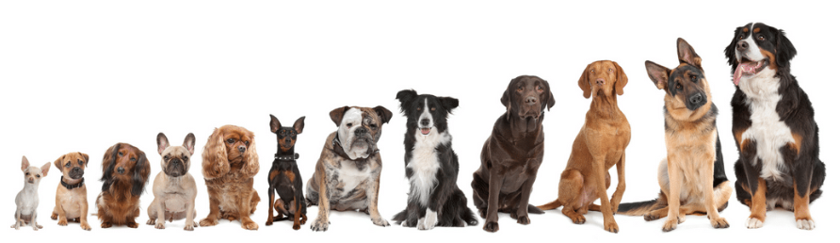

Summarise type of data
Variable is a property or characteristic measured in the population of individuals or objects
Qualitative variables - they measure non-numeric qualities.
  Nominals: There is no natural order between its categories. Example: The hair colour or the gender.
  Ordinals: data are ordered groups or categories (the data can be organised in a meaningful order). Example: The education level.
Quantitative variables - they measure numeric quantities.
  Interval (discrete): are ordered data where the differences between the values are meaningful (usually integers). There is no absolute 0.
    Example: The number of children in a family, temperature (0 does not mean the absence of temperature).
  Ratio (continuous): Ratio is the same as interval but they can take the value of an absolute 0.
    Example: The height, weight or age of a person.
breed
size
height
weight

Slide 33
Summarise typical Usability Testing Data
Statistical variables
Qualitative
Quantitative
Nominal
Ordinal
Interval
Ratio
The attribute can be named
In UX
Gender
Type of users (OS/Windows)
Users in different geographical locations
The attribute can be ordered/organized in a certain way
Study level
In UX
Ranked data (rank the 3 designs from 1st preference, 2nd preference, 3rd preference)
Ordered data where the differences between the values are meaningful
There is an absolute 0
In UX
Time
Score
Number of clicks/errors/steps
Ordered data where the differences between the values are meaningful
No absolute 0
In UX
Number of Children
Number of cars
Number of subjects
Scale values

Slide 34
Why Data Types are important?
Datatypes are an important concept because statistical methods can only be used with certain data types.
You have to analyse continuous data differently than categorical data otherwise it would result in a wrong analysis.
Therefore knowing the types of data you are dealing with, enables you to choose the correct method of analysis.

Slide 35
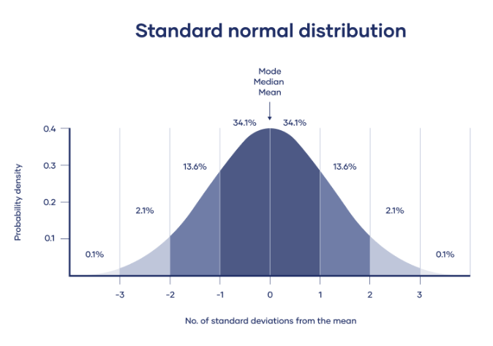
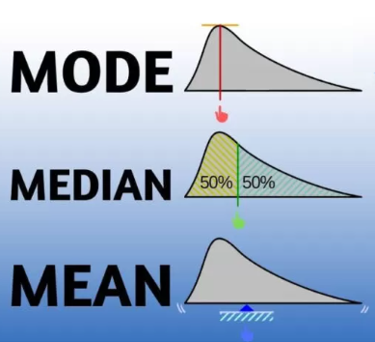
Typical statistical analysis - Measures of Central Tendency
When we study a data set, we often want to find out where the bulk of the data is located.
In statistical terms, this characteristic is called the “central tendency.”
Various measures can be used to describe the central tendency of a data set, including the:
  Mode – most common value
  Median – middle – the middle value in the data set
  Mean – average - the sum of all the numbers divided by the count of the numbers

Slide 36
Nominal Data Statistical Methods
When you are dealing with nominal data, you collect information through:
  Frequencies: The Frequency is the rate at which something occurs over a period of time or within a dataset.
  Proportion: You can easily calculate the proportion by dividing the frequency by the total number of events (e.g how often something happened divided by how often it could happen)
  Percentage.

Slide 37
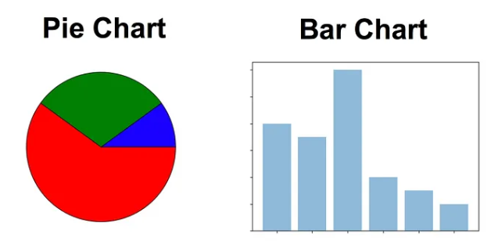
Visualization of Nominal Data Statistics
Visualisation Methods: To visualise nominal data you can use a pie chart or a bar chart.

Slide 38
Ordinal Data Statistical Methods
When you are dealing with ordinal data, you can use the same methods like with nominal data, but you also have access to some additional tools.
Therefore you can summarise your ordinal data with:
  Frequencies
  Proportions
  Percentages

Slide 39

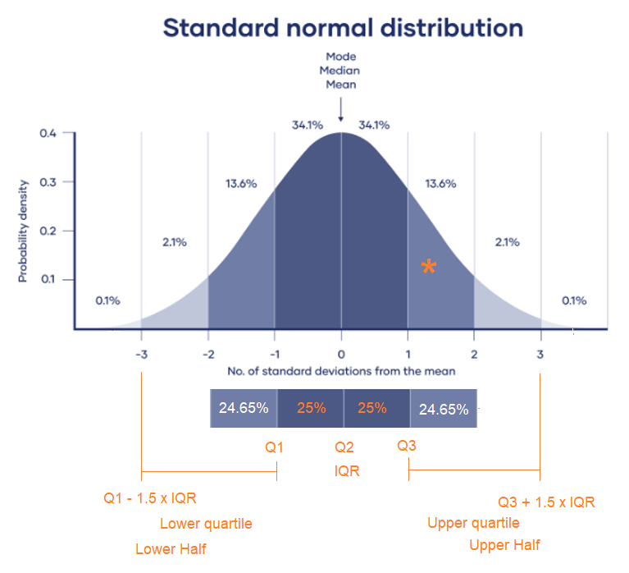
Visualization of Ordinal Data Statistics
Visualisation Methods: To visualise ordinal data you can use a pie chart or a bar chart.
Additionally, you can use percentiles (how users’ performance or experiences vary), median, mode and the interquartile range (the spread of the middle) to summarise your data.
Percentiles : 80% of people is slower than you in making first click (they did the first click within below 15secs from the start of the task)
Notes:
Percentiles are particularly useful in usability testing to understand how users’ performance or experiences vary. Here are some key examples:
Median (50th Percentile):
The median represents the middle of the data, meaning 50% of users performed better, and 50% performed worse. It’s a common benchmark for user performance in tasks, such as task completion time.
Lower and Upper Quartiles (25th and 75th Percentiles):
The 25th percentile represents the point below which 25% of users fall (the "lower quartile"), while the 75th percentile represents the point below which 75% of users fall (the "upper quartile"). These values help in identifying the range of typical user experiences and outliers.
90th or 95th Percentile:
These higher percentiles help to understand the experience of most users, excluding a small fraction of outliers. For example, the 90th percentile task time can show how long it took the vast majority (90%) of users to complete a task.
Why Use Percentiles in Usability Testing?
Percentiles allow you to:
Identify usability bottlenecks by showing where most users are struggling.
Measure and compare usability metrics across user groups.
Set realistic performance targets (e.g., aim for 90% of users to complete a task within a certain time).
Using percentiles helps in presenting data in a user-centered way, focusing on how most users interact with a product rather than only averages, which can sometimes be misleading.
The interquartile range (IQR) is a measure of statistical dispersion, which shows the range within which the middle 50% of data points lie. Specifically, it is the difference between the 75th percentile (upper quartile, Q3) and the 25th percentile (lower quartile, Q1):
IQR=Q3−Q1\text{IQR} = Q3 - Q1IQR=Q3−Q1What IQR Shows
Spread of the Middle 50%: The IQR shows how spread out the central half of the data is. A larger IQR indicates more variability within the middle 50%, while a smaller IQR suggests the data points are closer together.
Identifying Outliers: IQR is commonly used to identify outliers. Any data point below Q1−1.5×IQRQ1 - 1.5 \times \text{IQR}Q1−1.5×IQR or above Q3+1.5×IQRQ3 + 1.5 \times \text{IQR}Q3+1.5×IQR is often considered an outlier.
In Usability Testing
In usability testing, IQR can help understand the variability in user performance or experience. For example, in task completion times, a high IQR might indicate a diverse range of user speeds, suggesting that some users struggle more than others, while a low IQR suggests a consistent performance across users.

Slide 40
Interval/Ratio Data Statistical Methods
When you are dealing with continuous data, you can use the most methods to describe your data. You can summarise your data using percentiles, median, interquartile range, mean, mode, standard deviation, and range.

Slide 41
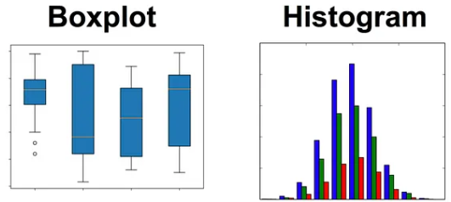
Visualization of Interval/Ratio Data Statistics
To visualise continuous (Interval/Ratio) data, you can use a histogram or a box-plot.
With a histogram, you can check the central tendency, variability, modality, and kurtosis of a distribution.
Note that a histogram can’t show you if you have any outliers. This is why we also use box-plots.

Slide 42


What data do we collect in usability testing studies?
Performance data
Preference data
Objective measure of behaviour, such as time, counts, rates of observed behaviour elements
This data comes from system logs, observation either of the live test or review of the video recording after the test has been completed
Subjective data that measures the participant’s feelings or opinion of the product
This data is collected via written, oral or even online questionnaires or through debriefing

Slide 43

What data do we collect in usability testing studies?
Emotions data
It is no longer good enough to design products that are easy and efficient to use. Products and services need to deliver better emotional outcomes to maintain a competitive advantage
 | Self-report | eye-tracking | Galvanic skin response | Facial expressions | Verbal expressions
Engagement | x | x | x | x | x
Trust | x |  |  |  | x
Confidence | x |  |  |  | x
Joy | x |  |  | x
Frustration | x |  |  |  | x
Stress | x |  | x |  | x
Surprise | x |  |  | x | x

Slide 44
How do we collect this data?
Observations
Self-reported data

Slide 45
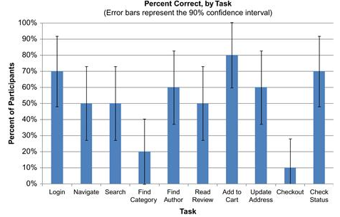
Performance data - task success
Task success | Binary success - users either completed a task successfully or they didn’t Assuming you have more than one participant and more than one task, there are always two ways you can calculate task success: • by looking at the average success rate for each task across the participants • by looking at the average success rate for each participant across the tasks
Participant | Login | Navigate | Search | Find Category | Find Author | Find Review | Add to Cart | Update address | Check-out | Check status | Averages
Participant 1
Participant 2
Participant 3

Slide 46
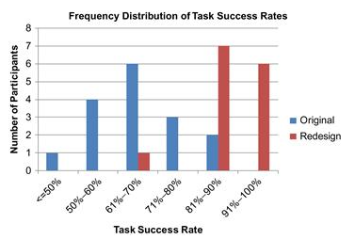
Performance data – level of success
Level of success | Complete success With assistance Without assistance Partial success With assistance Without assistance Failure User thought it was complete, but it wasn’t User gave up

Slide 47
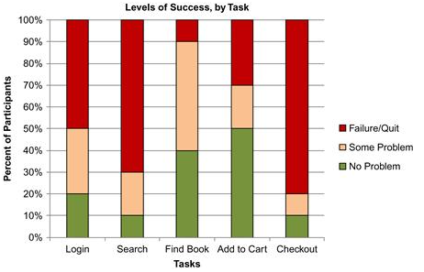
Performance data – level of success
Level of success | 1 = No problem. The user completed the task successfully without any difficulty or inefficiency. 2 = Minor problem. The user completed the task successfully but took a slight detour. He made one or two small mistakes but recovered quickly and was successful. 3 = Major problem. The user completed the task successfully but had major problems. She struggled and took a major detour in her eventual successful completion of the task. 4 = Failure/gave up. The user provided the wrong answer or gave up before completing the task or the moderator moved on to the next task before successful completion.

Slide 48
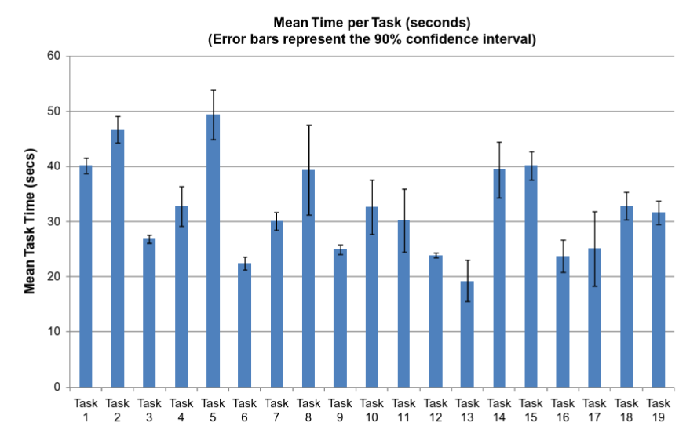
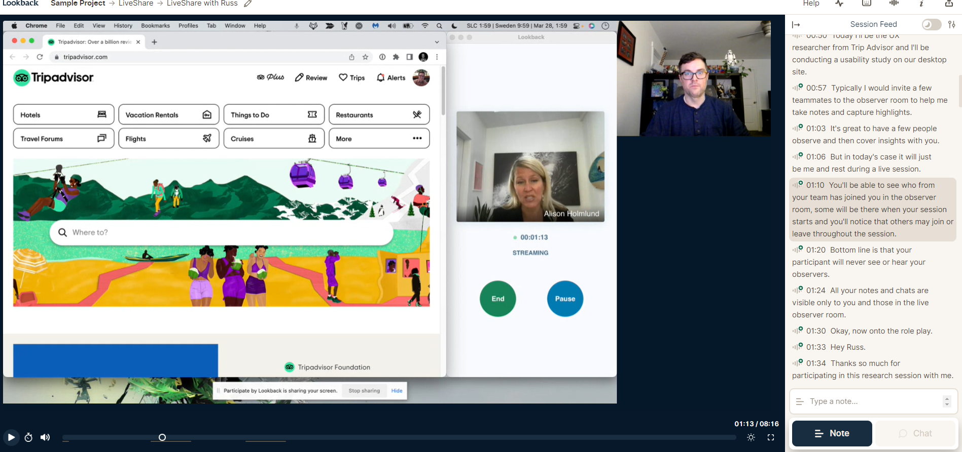
Performance data – time on task
Time durations | Time to complete a task Time to recover from an error Time to achieve a criterion level of competence Training time to achieve benchmark performance Time spent reading vs working
LookBack.io
Data can be analysed:
quantitatively | counting the number of errors made on a task
qualitatively | to expose places where the user does not understand the product’s conceptual model

Slide 49
Performance data – errors
What constitutes an error? | Entering incorrect data into a form field (such as typing the wrong password during a login attempt) Making the wrong choice in a menu or drop-down list (such as selecting “Delete” instead of “Modify”) Taking an incorrect sequence of actions (such as reformatting their home media server when all they were trying to do was play a recorded TV show) Failing to take a key action (such as clicking on a key link on a web page
How you collect error | 0 = No error 1 = One error Number of errors Number of errors per task
Data can be analysed:
quantitatively | counting the number of errors made on a task
qualitatively | to expose places where the user does not understand the product’s conceptual model

Slide 50
Performance data – efficiency
How to count efficiency? | Time on task is often used as a measure of efficiency The amount of effort required to complete a task (number of steps) What do we mean by effort? Cognitive effort involves finding the right place to perform an action (e.g., finding a link on a web page), deciding what action is necessary (should I click this link?), and interpreting the results of the action. Physical effort involves the physical activity required to take action, such as moving a mouse, inputting text on a keyboard, turning on a switch, and many others.
Data can be analysed:
quantitatively | counting the time or the tasks
qualitatively | to understand the factors that may affect time and task completion

Slide 51
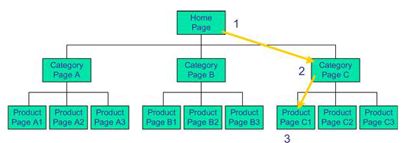
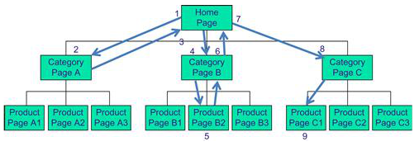
Performance data – efficiency
How to collect data for efficiency? | Identify the action(s) to be measured (mouse clicks, keystrokes, button presses) Define the start and end of an action Count the actions, actions must happen at a pace that can be identified visually or, if they are too fast, by an automated system. Actions must be meaningful, each action should represent an incremental increase in cognitive and/or physical effort

Slide 52
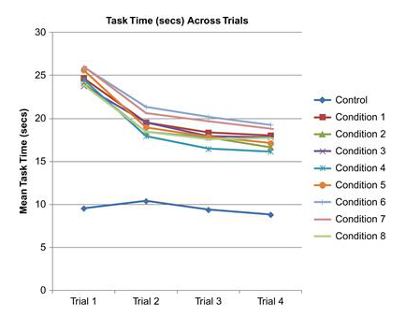
Performance data – learnability
How to count learnability? | Learnability involves looking at how any efficiency metric changes over time. Learnability is useful if you want to examine how and when users reach proficiency in using a product The process of collecting and measuring learnability data is the same as it is for the other performance metrics, but you’re collecting the data at multiple times that we identify as trials, so we can collect number of trials
Data can be analysed:
quantitatively | number of trials, time intervals

Slide 53
Preference data
Participants comments and opinions | Preference of version A vs version B in a competitive or comparative study Rating or ranking of the product Suggestions for improving the product Number of negative references to the product Rationales for performance (what the participant says about why he or she did what he or she did)
Data can be analysed:
quantitatively | number of positive or negative comments, repetitive patterns Rating or ranking of the product
qualitatively | each negative error can be analysed to discover the aspects of the product design the comment refers to

Slide 54
Self-reported data
Self-reported data, or self-report data, is information individuals provide about themselves, their experiences, behaviours, beliefs, or attitudes.
This type of data relies on individuals' self-awareness and willingness to share information about their own thoughts, feelings, and actions.
It is typically collected through surveys, questionnaires, interviews, diaries
Some key characteristics and examples of self-reported data:
Its subjective nature because it reflects the individual's perception and self-assessment
Its validity and reliability as collecting accurate self-reported data relies on the honesty and reliability of respondents. Factors such as social desirability bias (the tendency to respond in a socially acceptable way) and recall bias (inaccurate memory) can influence the quality of the data.
Anonymity and confidentiality are essential to encourage honest and candid responses

Slide 55
Questionnaires/survey format
Open-ended questions – allow the participant to express freely their opinion rather than choosing from a predetermined list
Binary questions
Branching questions – allow to control the path the participant will go through the questionnaire
Checklist response – the respondent is provided with a list of options and may select the ones that are applicable.
  Why do you use this tool?
  Do you think this icon is good for functionality X?
  Yes
  No
  If you answered “No” to question 2. Which of the following icons you think would convey the functionality of […] better?
  Option one
  Option two
  Option three
  Option three
  Option five

Slide 56
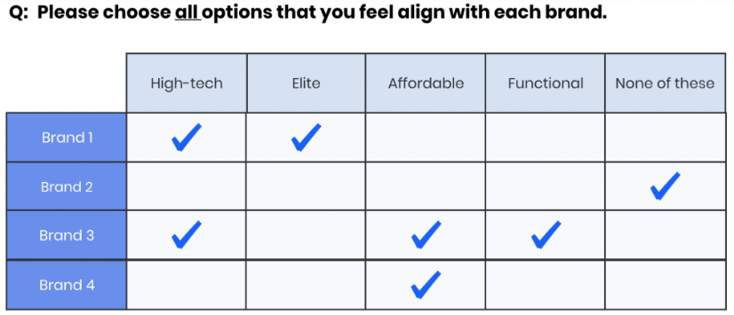
Questionnaires/survey format
Multiple Choice - the respondent has to choose one of (the preferred) the proposed options.
Category scaling – the respondent is asked to choose a response with respect to frequency.
Matrix of Choices (Only one Answer per Row)
Matrix of Choices (Multiple Answers per Row)
Matrix of Drop-down Menus
Where on the screen do you prefer the menu bar:
Top of the screen
Left of the screen
Right of the screen
How often do you use this app?
1
Always
2
Mostly
3
Sometimes
4
Never

Slide 57
Tips for creating questionnaires/survey
Be concise and precise
Do not direct/lead the user’s answer
Include items directly related to a specific research question(s)
Ask questions you cannot directly observe
Use a pilot test to refine the questionnaire
Avoid using terminology the users will not understand

Slide 58
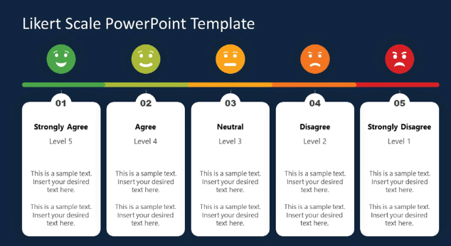

Rating scales
Likert scale
  Rensis Likert, a Psychologist, concluded in 1932 that he needed a mechanism to assess the intensity of people’s emotions. He created a linear scale for psychometrics—the measurement of people’s attitudes, values, internal feelings, and judgments about their own or others’ behaviour in research and therapeutic practice.
  “My suggestion is to use a 5-point scale when you have more than 100 respondents and a 7-point scale for smaller studies (N<100) when you need a better data distribution.”
  Dan Kelly, from The Negotiator Guru, March 2022

Slide 59
Post-task rating
Gather feedback and evaluate specific aspects of a user's experience immediately after they have completed a task or interaction with a product or system.
It is a form of self-report data collection that allows participants to share their thoughts, feelings, and perceptions regarding the task they just performed.
Common questions:
  How easy or difficult was it to complete the task?
  How satisfied are you with the process you just went through?
  How confident are you in the accuracy of the results?
  How likely are you to use this feature again?
  Is there anything you found confusing or frustrating during the task?

Slide 60
Post-task rating
Task Difficulty: Participants rate the perceived difficulty of completing a specific task using the product or system.
  1 = Very Difficult
  2 = Difficult
  3 = Neutral
  4 = Easy
  5 = Very Easy
Satisfaction: Participants rate their overall satisfaction with their user experience after completing a task.
  1 = Very Dissatisfied
  2 = Dissatisfied
  3 = Neutral
  4 = Satisfied
  5 = Very Satisfied
Efficiency: Participants rate how efficient the system was in helping them complete a task.
  1 = Very Inefficient
  2 = Inefficient
  3 = Neutral
  4 = Efficient
  5 = Very Efficient
Likelihood to Recommend: Participants rate how likely they are to recommend the product or system to others.
  1 = Very Unlikely
  2 = Unlikely
  3 = Neutral
  4 = Likely
  5 = Very Likely
Confidence in Accuracy: Participants rate their confidence in the accuracy of the results or outcomes of the task.
  1 = Not at all Confident
  2 = Somewhat Unconfident
  3 = Neutral
  4 = Somewhat Confident
  5 = Very Confident
Ordinal
Interval

Slide 61
Recap
When we conduct Usability testing
Usability testing goals
Types of Research
Variables
Data types
Statistical methods according to data type
Visualisation of different data types
Next week – Form a research question & hypothesis testing

Slide 62
Test your understanding
Why having a clear usability testing goal is important?
Which are the three different types of usability testing research goals you are aware of? And how do they differ?
What are the variables in usability testing research?
What type of variables exist in usability testing research?
What are the different data types you can collect in usability testing?
How those types of data differ?
How different type of data is related to usability metrics?
How different type of data can be collected?
How dependent data types are related to dependent and independent variables?
How can you statistically analyse different usability testing data?
How can you visualise different usability testing data?

Slide 63
Reading
Albert, B. & Tullis, T. (2013) Measuring the User Experience, 2nd Edition, Publisher(s): Morgan Kaufmann
  Chapter 2, Background
Lazar, J., Feng, J.H. and Hochheiser, H. (2017) Research methods in human-computer interaction. Second edition. Cambridge, Massachusetts: Morgan Kaufmann Publishers.
  Chapter 2, Experimental Research
Online Resources
  A Beginner's Guide to Usability Testing
    https://maze.co/guides/usability-testing/
  Types of statistical data
    https://towardsdatascience.com/data-types-in-statistics-347e152e8bee

